Slide 1
SOAR Community Services
Empowering people to achieve their vision of independence, health, and wellbeing

Slide 2
Addictions and Mental Health
Mary Dawdy, Crisis Services Manager
Julie Smith, Concurrent Disorders Program Manager

Slide 3
OUR APPROACH
To Clients…..
Strengths-based (emphasize and build on individual strengths)
Client-centred (seeing individuals as equal partners, matching to right care)
Evidence-informed (guided by research and experiential evidence)
To Programs and Services…..
Data-driven (informed by data and factual information)
Quality Improvement focused (continuous effort to provide better service)

Slide 4
ADDICTION AND MENTAL HEALTH (AMH)
3 main program areas:
Crisis Services
Outpatient Concurrent Disorders
Withdrawal Management and Treatment Services

Slide 5
CRISIS SERVICE CONTINUUM
Immediate Telephone Crisis Counselling
Mental Health Walk-in Clinic
Mobile Crisis Response Team
(MCRT)
Crisis Outreach & Support Team
(COAST)

Slide 6
CRISIS LINE
Who they serve | Support people experiencing mental health distress or situational “crisis” Professionals or family member who need guidance on where to connect people
What they do | Offer safety planning, coping strategies, connection to ongoing supports System navigation
How to access | Available 24/7, 365 days a year Call 519-759-7188 OR 1-866-811-7188
St. Leonard’s Community Services is also a proud partner in 9-8-8, Canada’s new helpline for anyone who is thinking about suicide or who is worried about someone they know. As a 9-8-8 partner, we are part of a network of local, provincial and territorial, and national crisis lines across the country whose responders take 9-8-8 calls and texts.
Notes:
Anyone can call, you don’t need to be experiencing suicidal ideation or be in a 10/10 crisis.
Staff can support in implementing coping strategies, like walking clients through deep breathing exercises or providing new coping strategies.
Staff complete suicide risk assessments and safety plans but also conduct wellness checks when necessary
Our crisis line staff can inform clients or caregivers about resources or services available in the community and complete referrals
Our crisis line staff also complete COAST referrals

Slide 7
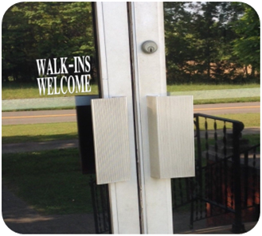
MENTAL HEALTH WALK-IN
Who they serve | Support people experiencing mental health distress or situational “crisis”
What they do | Brief, solution focused counselling (increasing coping strategies, complete referrals, complete suicide risk assessments and safety plans)
How to access | No referral or appointment required, just show up! 225 Fairview Drive Unit 1: Mondays and Wednesdays 2 – 7 pm
Notes:
Session are generally one hour in length
Commonly servicing and supporting family members as well, servicing all ages

Slide 8
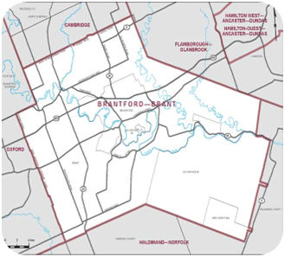
CRISIS OUTREACH AND SUPPORT TEAM (COAST)
Who they serve | Our Crisis Outreach and Support Team (COAST) provides short-term (1 to 3 sessions) crisis stabilization support to individuals and families of any age.
What they do | Work with you to develop a plan to manage the distressing situation and strength coping skills Conduct risk assessment, safety plans, and use inventions to prevent further crisis Provides referrals to internal and external resources Provides a range of accessible services including outreach to your home or environment of your choosing, school, in office or virtual.
How to access | Call the crisis line at 519-759-7188 to make a referral OR complete a COAST Referral Form and Fax to 226-401-3823 https://www.soarcs.ca/addictions-and-mental-health/program/crisis-outreach-and-support-team-coast
Notes:
Some of our services are offered in partnership with Brantford Police and Brant County OPP

Slide 9
Mobile Crisis Response Team (MCRT)
Who they serve | The Mobile Crisis Response Team (MCRRT) responds to 911 calls where mental health concerns and/or crises are identified. The team pairs a Mental Health Specialist with a police officer from Brantford Police Services or Brant County OPP.
What they do | Assessment of risk to the safety of the person and others On-site safety planning De-escalation Stabilization strategies Referrals
How to access | MCRT only responds to 911 calls. Contact our Crisis Telephone Line for other crisis counselling support.
Notes:
If you are contacting police due to concerns of the wellbeing of someone who you think/know is in a mental health crisis your can request MCRT to dispatch
They are not guaranteed to respond.

Slide 10
CONCURRENT DISORDERS OUTPATIENT SERVICES
CD Program
Office-based and outreach support
RAAM
Walk-in access to multidisciplinary team support
Harm Reduction
Harm reduction supplies

Slide 11
CONCURRENT DISORDERS
Who they serve | Individuals aged 12 and up who want to discuss their substance use or concurrent disorder Family/loved ones of people who use substances
What they do | Assessment and treatment planning, individualized support plans, referral to more intensive programs Use evidence-based assessment tool and approaches (MI, CBT, Stages of Change, DBT) Group programs including peer support, art therapy, relapse prevention, DBT skills Can do outreach to mitigate access barriers (including in hospital)
How to access | Call 519 754 0253 Mon – Wed 830 – 7, Thurs – Fri 830 - 5 *Same day intake and assessment available! *Evening appointments routinely offered

Slide 12
OPEN GROUP SUPPORTS

Slide 13
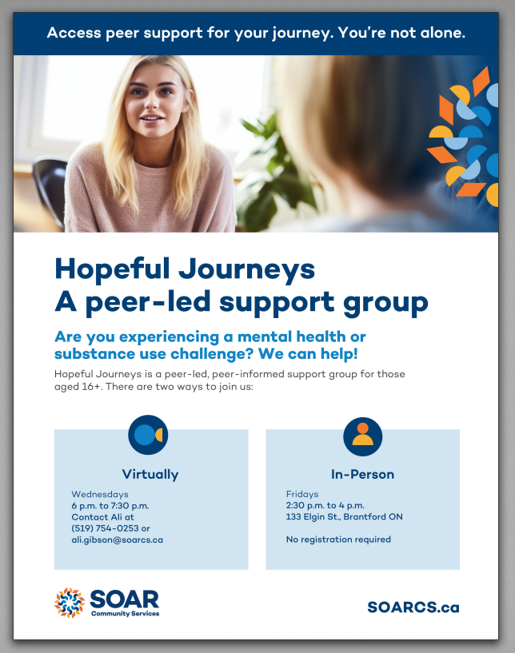
OPEN GROUP SUPPORTS

Slide 14
RAAM – RAPID ACCESS ADDICTION MEDICINE
Who they serve | Individuals with substance use disorder or concurrent disorder
What they do | Provide addiction medicine, counselling and case management for any/all substance use Access to psychiatry for identified patients
How to access | Walk-ins welcome Dunnville (140 Broad Street): Mondays 9 am – 3 pm Simcoe (32 Robinson St): Thursdays 9 am – 3 pm Brantford (320 Colborne St. E.): Tuesdays 9 am – 6 pm, Wednesdays 9 am – 1 pm, and Fridays 9 am – 3 pm Call 519 758 0008 for more information

Slide 15
HARM REDUCTION
Who they serve | Anyone who needs supplies and/or uses substances
What they do | Provide safe use supplies and naloxone to prevent harms associated with use such as infection, communicable disease transmission, and overdose
How to access | 133 Elgin Street: Monday to Friday 9 am – 5 pm 225 Fairview Drive: Monday to Wednesday 830 am – 7 pm, Thursday and Friday 830 am – 430 pm

Slide 16
WITHDRAWAL MANAGEMENT AND TREATMENT SERVICES
Withdrawal Management
Day Treatment
Residential Treatment

Slide 17
WITHDRAWAL MANAGEMENT
Who they serve | Anyone aged 16 and older who requires residential support for safe withdrawal from substances
What they do | Screen to determine eligibility (safety in program) Comprehensive biopsychosocial supports from multidisciplinary team including NP, RPN, service coordinator, withdrawal management workers, and peer support Provide guidance on other services that may be required or support while waiting
How to access | Call for screening and bed availability 24/7 519 753 6222

Slide 18
DAY TREATMENT
Who they serve | Individuals aged 16 and older with an addiction or concurrent disorder who have been assessed as having a moderate to severe issue, and who wish to make some changes to their use
What they do | 5-week group therapeutic program using Stages of Change, CBT and DBT based content to support individual recovery process Includes 1 to 1 counselling, individualized support plans, connection to follow up support, access to peer support
How to access | Individuals must have been assessed and referred using standard provincial assessment Contact Concurrent Disorders Outpatient program for assessment (519 754 0253)

Slide 19
RESIDENTIAL TREATMENT
Who they serve | Individuals aged 16 and older with an addiction or concurrent disorder who have been assessed as having a severe issue, who wish to make some changes to their use, and are unable to do so in the community
What they do | 5-week group therapeutic program using Stages of Change, CBT and DBT based content to support individual recovery process Includes 1 to 1 counselling, individualized support plans, transition plan, case management, access to peer support and art therapy
How to access | Individuals must have been assessed and referred using standard provincial assessment Contact Concurrent Disorders Outpatient program for assessment (519 754 0253)

Slide 20
How you can support
Share information, the crisis line and walk-in clinic are great ways to start connection to services
Having a welcoming and non-judgmental environment where parents or caregivers feel comfortable discussing concerns about their child’s or own mental health
Normalize help seeking. If a conversation comes up where you don’t know how to respond offer to connect them to a service that does. Call our crisis line together.
Follow up with parents to see if they were able to connect to the services you suggested. Offer additional support as needed.
Collaborate with services, if you think there is important information we should know, contact us. Consent from the client is required.

Slide 21
Signs to watch for
You may notice a change in behaviour, such as irritability, withdrawing, aggression. Persistent worry, anxiety or preoccupation.
Frequent absences or lateness without explanation could be a sign of family stress
Neglecting personal hygiene or self-care or responsibilities at home or work
Signs of substance use may include bloodshot eyes, dilates pupils, tremors, slurred speech.
If a child expresses concerns or worries about a family member behaviour or wellbeing
Frequent arguments or tension in the home or signs of tension in the home.
It’s important for educators to approach these observations with sensitivity and discretion, respecting individuals' privacy.
Notes:
It's important for educators to approach these observations with sensitivity and discretion, respecting the privacy and dignity of the individuals involved. When concerns arise, educators can offer support and guidance to help the family access appropriate mental health resources and services.

